Slide 1
Tyepmg Pic Gvctxskvetlc

Slide 2
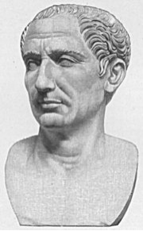
The Caesar Cipher (Suetonius)
“If Caesar had anything confidential to say, he wrote it in cipher, that is, by so changing the order of the letters of the alphabet, that not a word could be made out. If anyone wishes to decipher these, and get at their meaning, he must substitute the fourth letter of the alphabet, namely D, for A, and so with the others.”

Slide 3
Tyepmg Pic Gvctxskvetlc

Slide 4
Public Key Cryptography
How to Exchange Secrets
in Public!

Slide 5
Cryptosystems
encrypt
decrypt
plaintext message
plaintext message
ciphertext
SENDER
key
key
RECEIVER
retreat at dawn
sb%6x*cmf
retreat at dawn
ciphertext
Alice
Bob
ATTACKER
Eve
Notes:
Basic setup for confidentiality.
Various kinds of attacks.

Slide 6
How to Get the Key from Alice to Bob on the (Open) Internet?
1324-5465-2255-9988
Sf&*&3vv*+@@Q
1324-5465-2255-9988
SENDER
key
key
RECEIVER
(Alice’s Credit Card #)
The Internet
(Alice’s Credit Card #)
Alice
(You)
Bob
(An on-line store)
ATTACKER
(Identity thief)
Eve
Notes:
Basic setup for confidentiality.
Various kinds of attacks.

Slide 7
A Way for Alice and Bob to agree on a secret key
through messages that are completely public

Slide 8
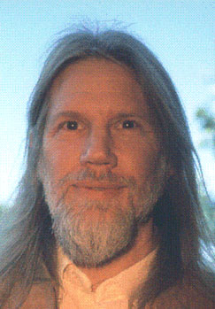
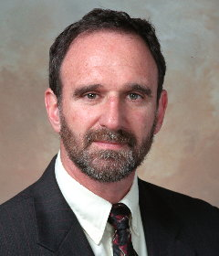
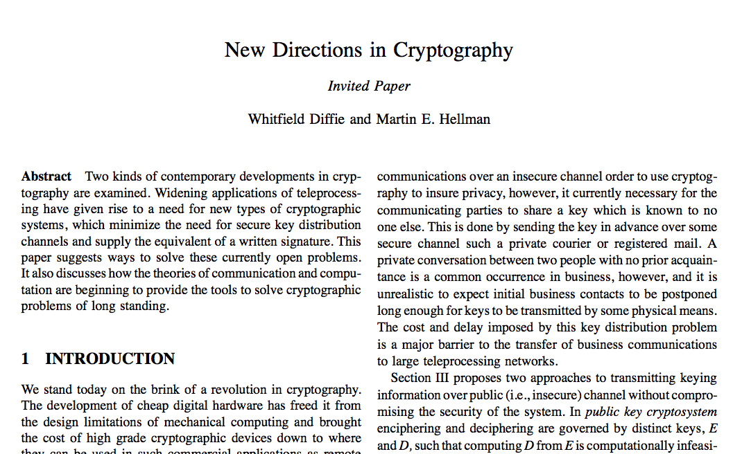
1976

Slide 9
The basic idea of Diffie-Hellman key agreement
Arrange things so that
Alice has a secret number that only Alice knows
Bob has a secret number that only Bob knows
Alice and Bob then communicate something publicly
They somehow compute the same number
Only they know the shared number -- that’s the key!
No one else can compute this number without knowing Alice’s secret or Bob’s secret
But Alice’s secret number is still hers alone, and Bob’s is Bob’s alone
Sounds impossible …

Slide 10
One-Way Computation
Easy to compute, hard to “uncompute”
What is 28487532223✕72342452989?
Not hard -- easy on a computer -- about 100 digit-by-digit multiplications
What are the factors of
206085796112139733547?
Seems to require vast numbers of trial divisions

Slide 11
Recall there’s a shortcut for computing powers
Problem: Given q and p and n, find y such that
q^{n} = y (mod p)
Using successive squaring, can be done in about log₂n multiplications

Slide 12
“Discrete logarithm” problem
Problem: Given q and p and y, find n such that
q^{n} = y (mod p)
It is easy to compute modular powers but seems to be hard to reverse that operation
For what value of n does 54321^{n}=18789 mod 70707?
Try n=1, 2, 3, 4, …
Get 54321^{n}= 54321, 26517, 57660, 40881 … mod 70707
n=43210 works, but no known quick way to discover that. Exhaustive search works but takes too long

Slide 13
Discrete Logarithms
Given q and p, and an equation of the form
q^{n} = y (mod p)
Then it seems to be exponentially harder to compute n given y, than it is to compute y given n, because we can compute q^{n} (mod p) in log₂n steps, but it takes n steps to search through the first n possible exponents.
For 500-digit numbers, we’re talking about a computing effort of 1700 steps vs. 10⁵⁰⁰ steps.

Slide 14
Discrete logarithm seems to be a one-way function
Fix numbers q and p (big numbers, q<p)
Let f(a) = qª (mod p)
Given a, computing f(a)=A is easy
But it is impossibly hard, given A, to find an a such that f(a)=A.

Slide 15
Diffie-Hellman
A
B
Alice
Bob
Pick a secret number a
Pick a secret number b
Compute A = f(a)
Compute B = f(b)
Shout out A
Shout out B
Compute Bª (mod p)
Compute A^{b} (mod p)
Main point: Alice and Bob have computed the same number, because
Bª = f(b)ª = (q^{b}) ª = (qª)^{b} = f(a)^{b} = A^{b} (mod p)
Use this number as the encryption key!

Slide 16
Diffie-Hellman Key Agreement
A
B
Alice
Bob
Eve
Let
Alice and Bob can now use this number as a shared key for encrypted communication
Eve the eavesdropper knows A = f (a) and B = f (b).
And she can even know how to compute f. But going from these back to a or b requires reversing a one-way computation.

Slide 17
Secure Internet Communication
https://www99.americanexpress.com/
https (with an “s”) indicates a secure, encrypted communication is going on
We are all cryptographers now
So is Al Qaeda(?)
Internet security depends on difficulty of factoring numbers -- doing that quickly would require a deep advance in mathematics

Slide 18
FINIS

